Slide 1

Application of R and Real-world Data to Customise Cancer Therapy By: Vivek Verma Research Consultant, Advanced Epidemiology For: Date: 2022-NOV-16

Slide 2
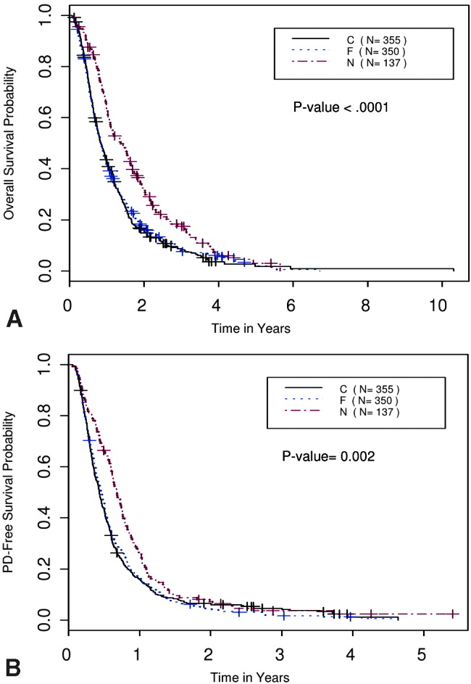



What we knew:
Non-small cell lung cancer (NSCLC)
Overall survival probability
Former smoker
Current smoker
Never smoker
Progressive disease-free survival probability
Former smokers
(50.8%)
Current smokers
(36.7%)
Never smokers
(12.5%)
Years
Siegel, D. A., et al. "Proportion of Never Smokers among Men and Women with Lung Cancer in 7 Us States." JAMA Oncol 7.2 (2021): 302-04.
Tsao, A. S., et al. "Smoking Affects Treatment Outcome in Patients with Advanced Non-small Cell Lung Cancer." Cancer 106.11 (2006): 2428-36.
vivek.verma@cytel.com

Slide 3


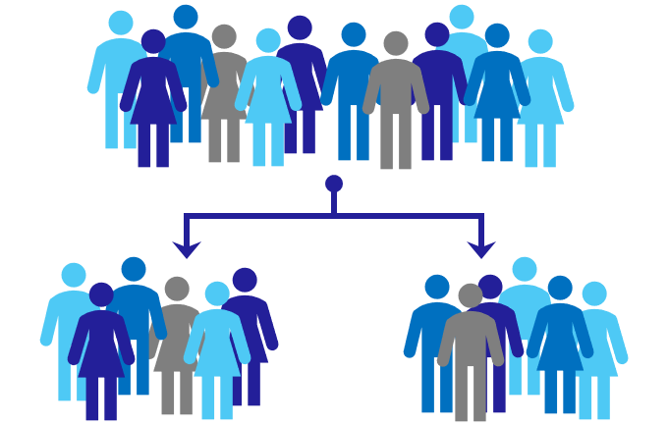


What we were doing:
Real-world data analysis
Randomised control trials
NSCLC patients on anti-PD-1/PD-L1 monotherapy
Ever-smokers Never-smokers
Drug A Drug B
vivek.verma@cytel.com

Slide 4
What we were doing:
Real-world data analysis
Randomised control trials
NSCLC patients on anti-PD-1/PD-L1 monotherapy
Ever-smokers Never-smokers
Drug A Drug B
vivek.verma@cytel.com

Slide 5
What we were doing:
Real-world data analysis
Randomised control trials
NSCLC patients on anti-PD-1/PD-L1 monotherapy
Ever-smokers Never-smokers
Drug A Drug B
vivek.verma@cytel.com

Slide 6
What we were doing:
Real-world data analysis
Randomised control trials
Confounders
NSCLC patients on anti-PD-1/PD-L1 monotherapy
Exposure
Outcome
Ever-smokers Never-smokers
Drug A Drug B
Imbens, Guido W. "Nonparametric Estimation of Average Treatment Effects under Exogeneity: A Review." Review of Economics and Statistics 86.1 (2004): 4-29
vivek.verma@cytel.com

Slide 7

What we were doing:
Real-world data analysis
Randomised control trials
Confounders
NSCLC patients on anti-PD-1/PD-L1 monotherapy
Exogeneity | unconfoundedness
Exposure
Outcome
Ever-smokers Never-smokers
Drug A Drug B
Imbens, Guido W. "Nonparametric Estimation of Average Treatment Effects under Exogeneity: A Review." Review of Economics and Statistics 86.1 (2004): 4-29
vivek.verma@cytel.com

Slide 8

What we were doing:
Real-world data analysis
Randomised control trials
Confounders
NSCLC patients on anti-PD-1/PD-L1 monotherapy
Exogeneity | unconfoundedness
Exposure
Outcome
Ever-smokers Never-smokers
Drug A Drug B
Imbens, Guido W. "Nonparametric Estimation of Average Treatment Effects under Exogeneity: A Review." Review of Economics and Statistics 86.1 (2004): 4-29
vivek.verma@cytel.com

Slide 9

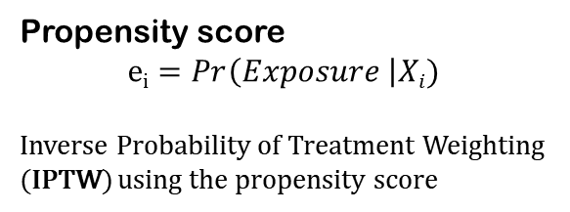
What we were doing:
Real-world data analysis
Randomised control trials
Confounders
NSCLC patients on anti-PD-1/PD-L1 monotherapy
Propensity score
$$ei=Pr\left(Exposure \right|Xi)$$
Inverse Probability of Treatment Weighting (IPTW) using the propensity score
Exogeneity | unconfoundedness
Exposure
Outcome
Ever-smokers Never-smokers
Drug A Drug B
Imbens, Guido W. "Nonparametric Estimation of Average Treatment Effects under Exogeneity: A Review." Review of Economics and Statistics 86.1 (2004): 4-29
vivek.verma@cytel.com

Slide 10
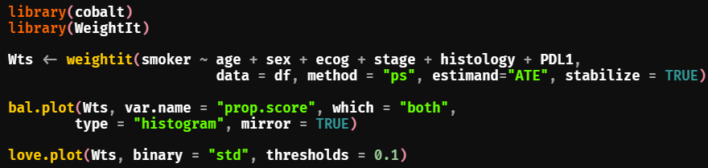
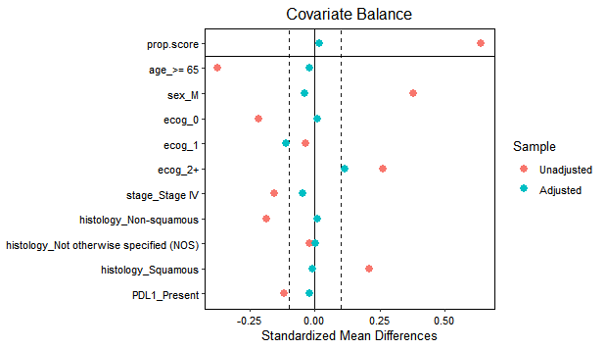
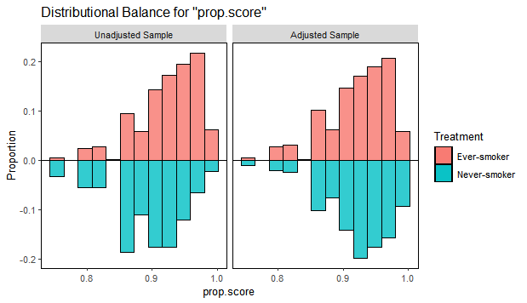
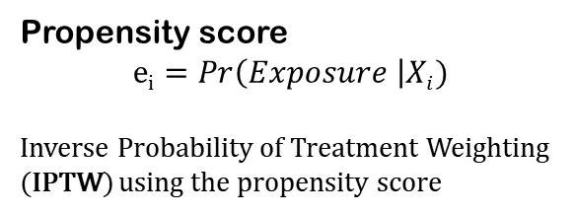
How we did it:
Confounders
Propensity score
$$ei=Pr\left(Exposure \right|Xi)$$
Inverse Probability of Treatment Weighting (IPTW) using the propensity score
Exposure
Outcome
Greifer N. "WeightIt: Weighting for Covariate Balance in Observational Studies." https://ngreifer.github.io/WeightIt (2022)
Greifer N. "cobalt: Covariate Balance Tables and Plots." https://ngreifer.github.io/cobalt (2022)
vivek.verma@cytel.com

Slide 11
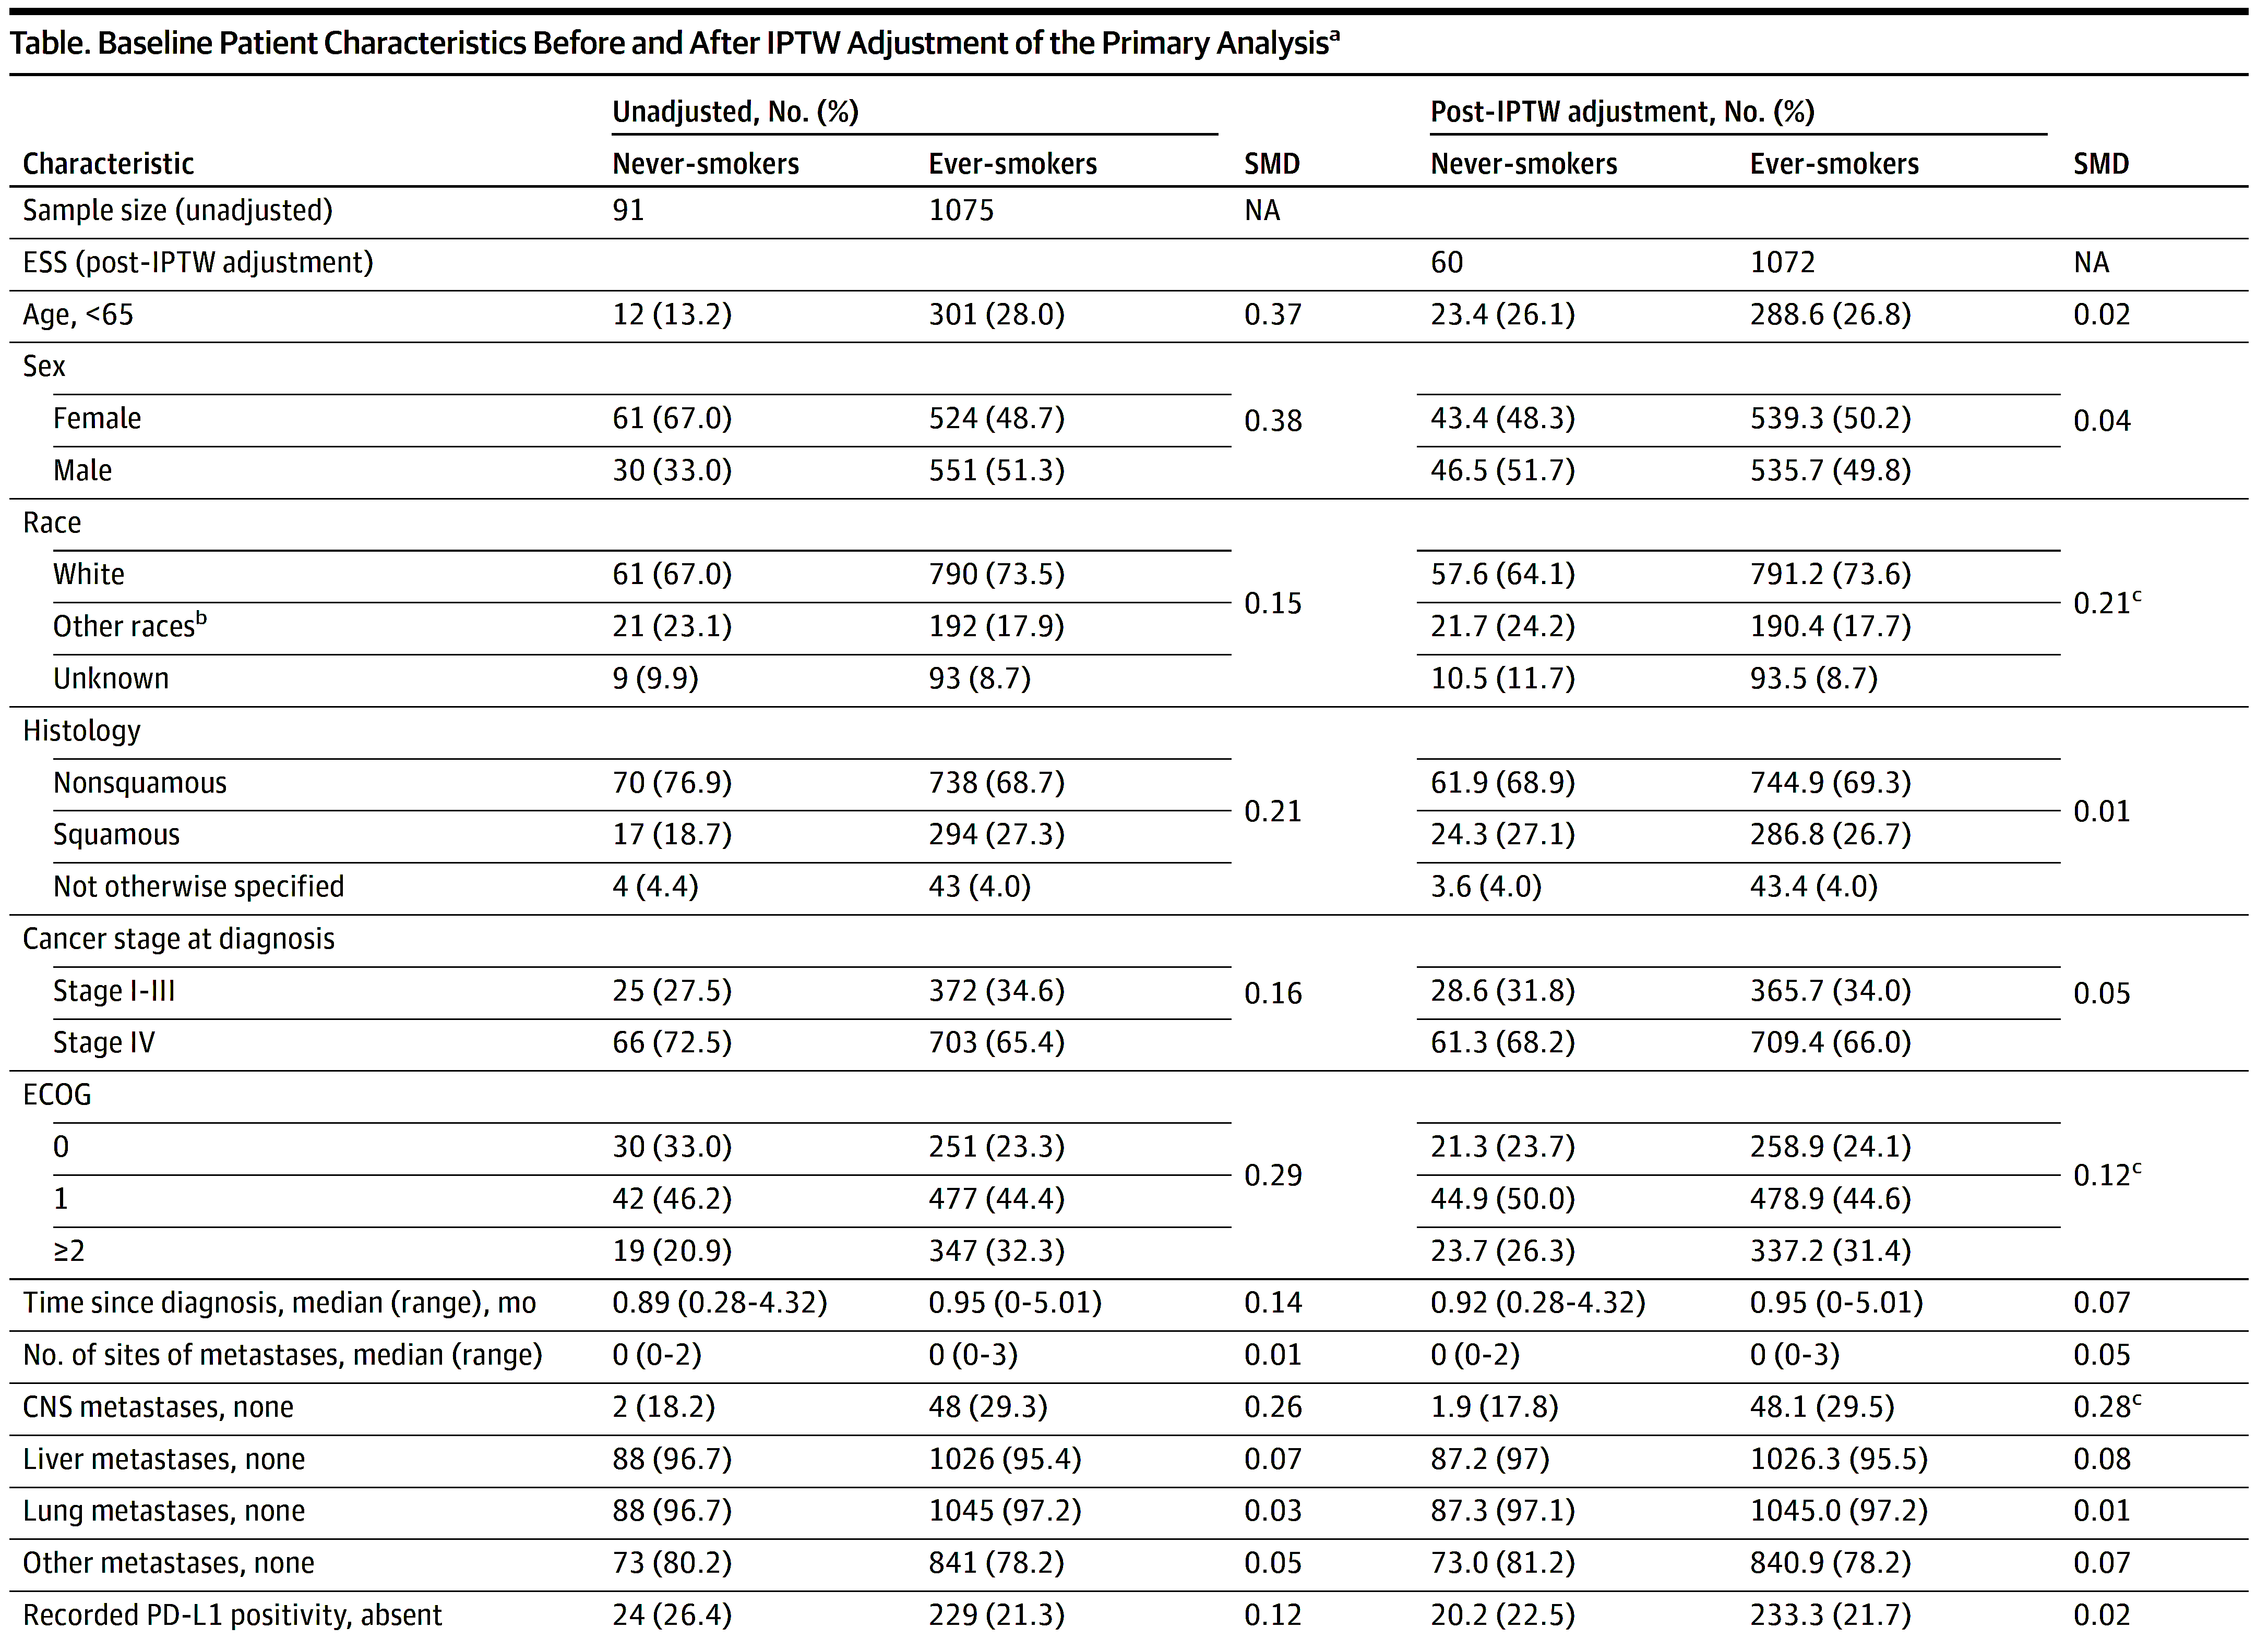
What we found:
IPTW
Yoshida K and Bartel A. "tableone: Create 'Table 1' to Describe Baseline Characteristics with or without Propensity Score Weights." https://CRAN.R-project.org/package=tableone (2022)
Therneau T. "A Package for Survival Analysis in R." https://CRAN.R-project.org/package=survival (2022)
vivek.verma@cytel.com

Slide 12
What we found:
IPTW
Already balanced
Yoshida K and Bartel A. "tableone: Create 'Table 1' to Describe Baseline Characteristics with or without Propensity Score Weights." https://CRAN.R-project.org/package=tableone (2022)
Therneau T. "A Package for Survival Analysis in R." https://CRAN.R-project.org/package=survival (2022)
vivek.verma@cytel.com

Slide 13
What we found:
IPTW
Already balanced
Balanced post-IPTW
Yoshida K and Bartel A. "tableone: Create 'Table 1' to Describe Baseline Characteristics with or without Propensity Score Weights." https://CRAN.R-project.org/package=tableone (2022)
Therneau T. "A Package for Survival Analysis in R." https://CRAN.R-project.org/package=survival (2022)
vivek.verma@cytel.com

Slide 14
What we found:
IPTW
Already balanced
Balanced post-IPTW
Unbalanced post-IPTW
Yoshida K and Bartel A. "tableone: Create 'Table 1' to Describe Baseline Characteristics with or without Propensity Score Weights." https://CRAN.R-project.org/package=tableone (2022)
Therneau T. "A Package for Survival Analysis in R." https://CRAN.R-project.org/package=survival (2022)
vivek.verma@cytel.com

Slide 15
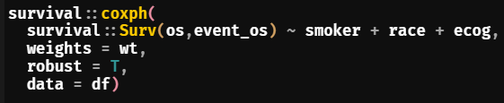
What we found:
IPTW
Already balanced
Balanced post-IPTW
Unbalanced post-IPTW
Yoshida K and Bartel A. "tableone: Create 'Table 1' to Describe Baseline Characteristics with or without Propensity Score Weights." https://CRAN.R-project.org/package=tableone (2022)
Therneau T. "A Package for Survival Analysis in R." https://CRAN.R-project.org/package=survival (2022)
vivek.verma@cytel.com

Slide 16
What we found:
Kaplan-Meier curves
Real-world data analysis
A
B
Unweighted IPTW weighted
HR = 0.85 (95% CI: 0.61 – 1.19)
p-value = 0.813
HR = 0.68 (95% CI: 0.47 – 0.98)
p-value = 0.037
NSCLC patients on anti-PD-1/PD-L1 monotherapy
Overall survival
Ever-smokers Never-smokers
Time (months)
Kassambara A et. al. "survminer: Drawing Survival Curves using 'ggplot2'." https://CRAN.R-project.org/package=survminer (2021)
Therneau T. "A Package for Survival Analysis in R." https://CRAN.R-project.org/package=survival (2022)
vivek.verma@cytel.com

Slide 17
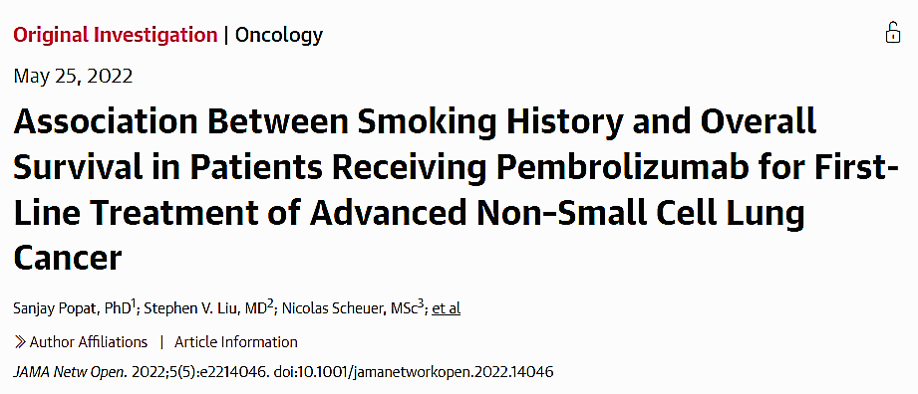
The publication:
vivek.verma@cytel.com

Slide 18
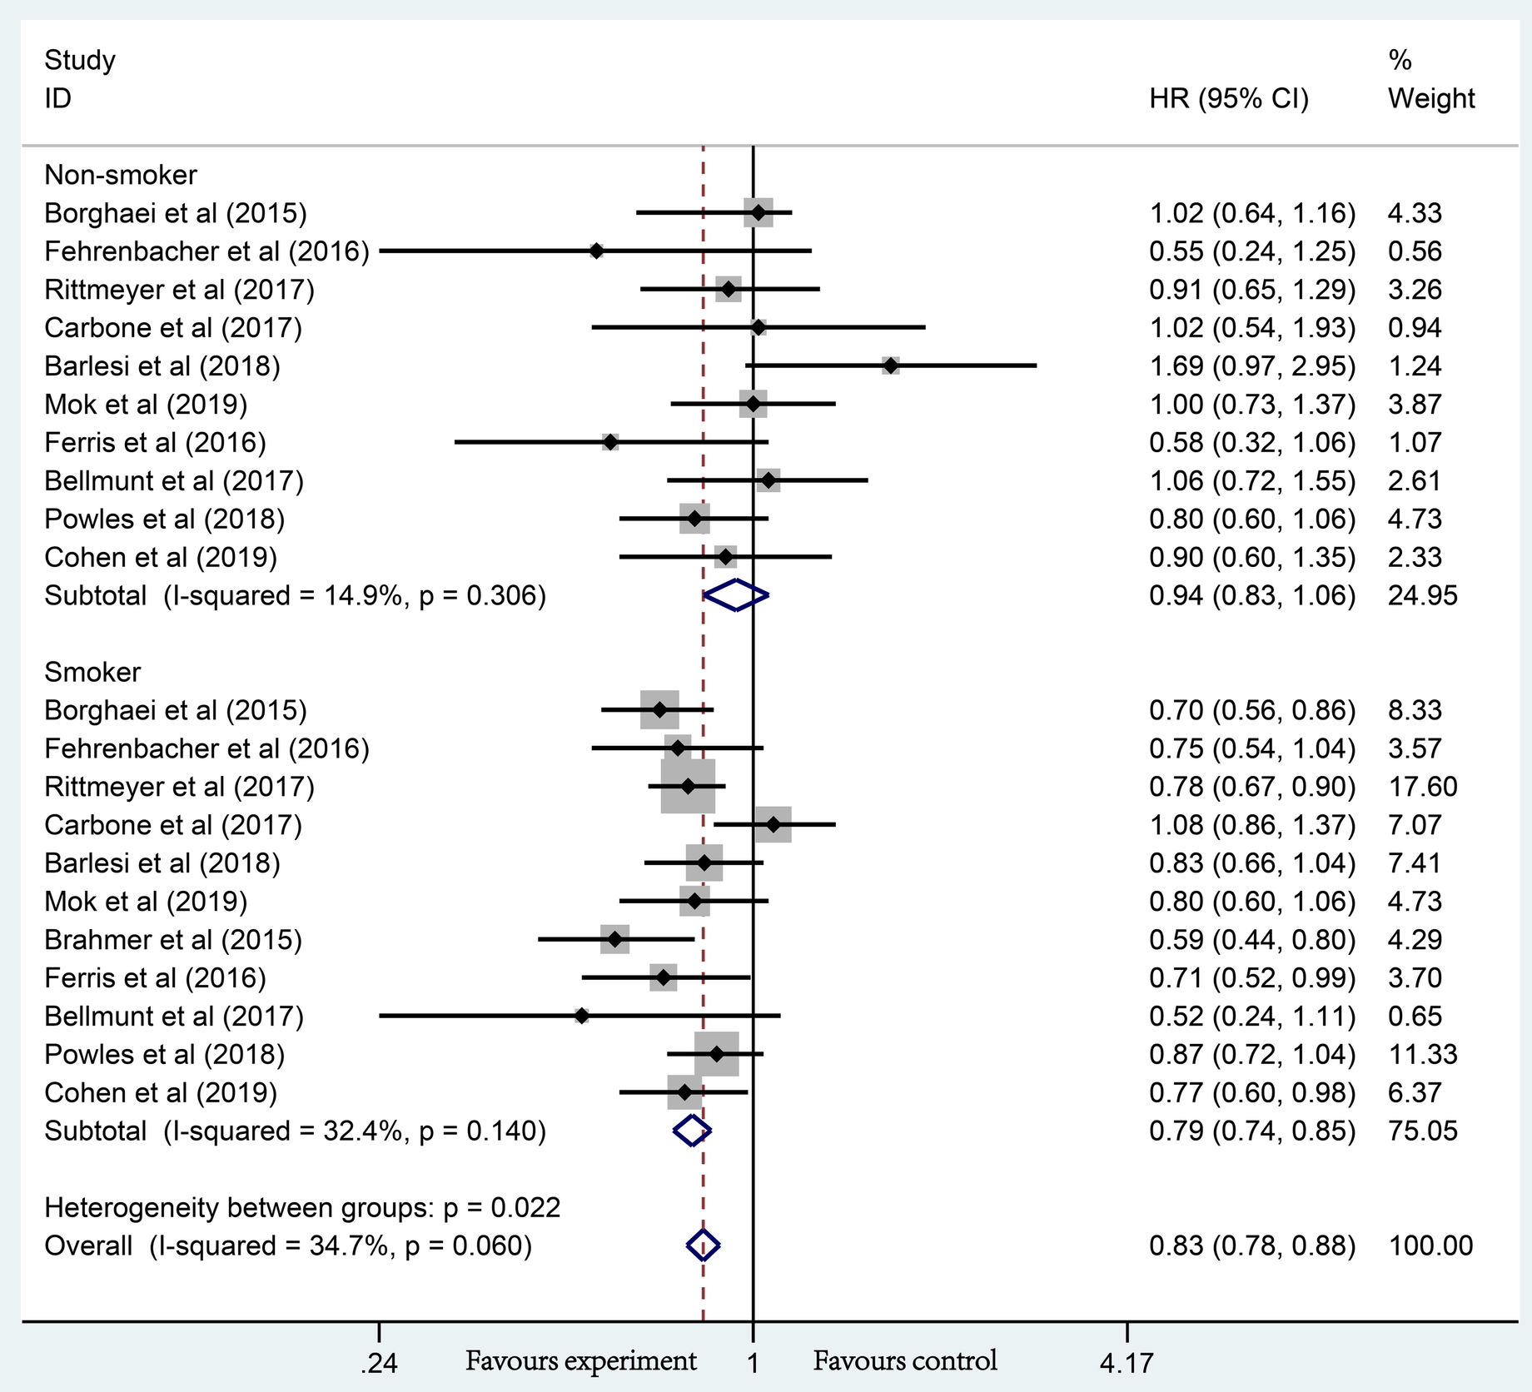
What we also found:
RCT meta-analysis
Forest plot of the long-term prognostic outcomes of anti-PD-1/PD-L1 monotherapy
P_{Non-smoker} = 0.304
P_{Smoker} < 0.001
Mo, J., et al. "Smokers or Non-Smokers: Who Benefits More from Immune Checkpoint Inhibitors in Treatment of Malignancies? An up-to-Date Meta-Analysis." World J Surg Oncol 18.1 (2020): 15.
vivek.verma@cytel.com

Slide 19





What we learned:
Real-world data can compliment RCTs in identifying causal signals
is a powerful tool for advance analytics
tableone
survminer
vivek.verma@cytel.com

Slide 20
What we learned:
Real-world data can compliment RCTs in identifying causal signals
is a powerful tool for advance analytics
tableone
survminer
vivek.verma@cytel.com

Slide 21
What we learned:
Real-world data can compliment RCTs in identifying causal signals
is a powerful tool for advance analytics
tableone
survminer
vivek.verma@cytel.com

Slide 22
Thank-you!
vivek.verma@cytel.com

